Slide 1

Capstone Project – Car accident severity
Elida Axundzada – November 11, 2020

Slide 2
Introduction
Road traffic accidents cause every year millions of deaths
Dataset: collected since 2004 to present in Seattle
Purpose: to analyse the dataset to create an application for drivers

Slide 3
Data acquisition & Data cleaning
DATA ACQUISITIONS
194,673 observations with 37 attributes
To predict the possibility of an accident/collision, we used the following attributes:
Collision address type {ADDRTYPE}
Weather {WEATHER}
Light conditions {LIGHTCOND}
Road conditions {ROADCOND}
DATA CLEANING
NaN values AND Unknown data were dropped for better processing

Slide 4
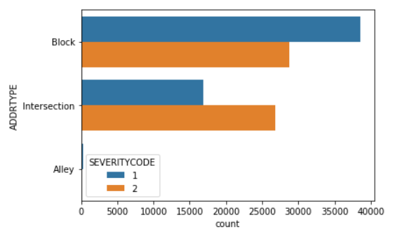
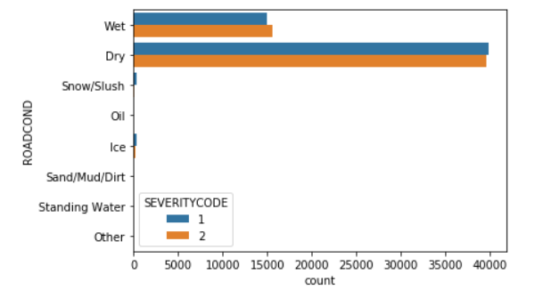
Exploratory analysis
→ Severity Code and Address Type: Severity Code 1 collisions along Blocks are more than on Intersections. The collisions of Severity Code 2 are almost the same on both Blocks and Intersections
→ Severity Code and Road Conditions: most number of collisions happen on dry roads

Slide 5
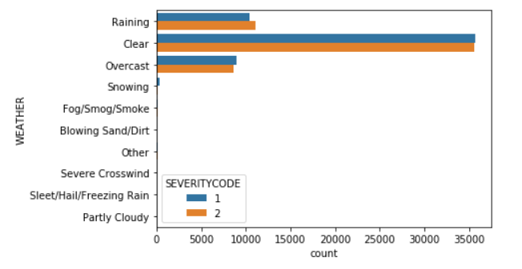
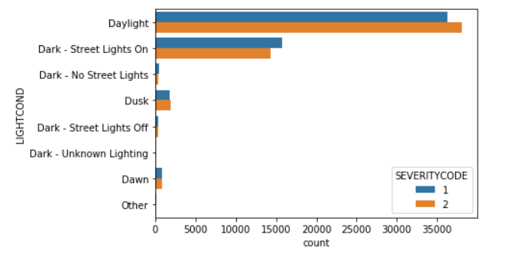
Exploratory analysis (2)
→ Severity Code and Weather: most number of collisions happen on Clear weather
→ Severity Code and Light Conditions: most number of collisions happen on daylight.

Slide 6
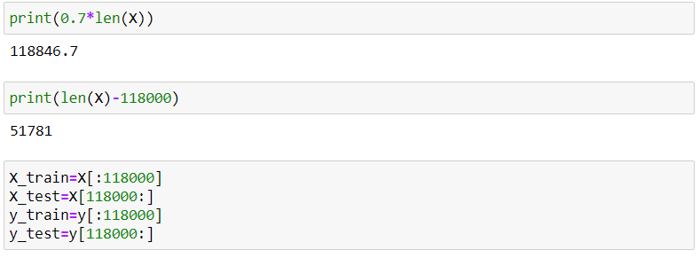
Machine learning model
One-hot encoding: independent variables are transformed to the format that can be fit to the machine learning model by using one-hot encoding
Data split: dataset is divided into a training set and a test set

Slide 7
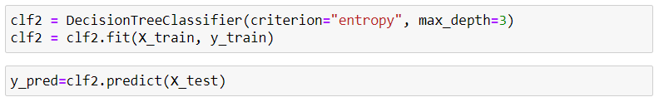
Machine learning model (2)
Decision Tree Model
Model evaluation: model accuracy has a rate of 65,68%.

Slide 8
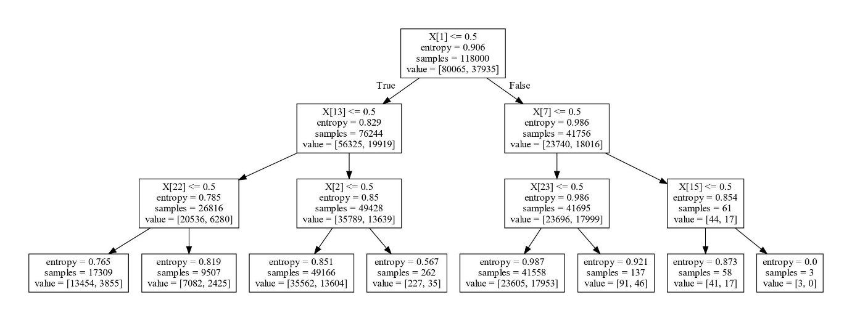
Machine learning model (3)

Slide 9
Conclusion
Collision address type, weather condition, road condition, light condition are choses as to predict the severity of a collision.
Exploratory analysis: most of the collisions happen on clear weather, dry road and daylight.
Decision tree shows us:
When the collision happens in intersection, it is in daylight and road wet
When the collision happens on alley, we do not have exact information on the weather
→ High number of false negatives to predict SEVERITYCLASS=2 and our results are biased because of imbalanced data issue

Slide 10
Futures directions
Increase the accuracy of our model by:
Considering other features for analysis
Grouping independent variables into groups
Balancing data
Use different algorithms:
K-Nearest Neighbours (KNN)
Logistic Regression

